Slide 1
LOS Discovery for Highly Directional Full Duplex RF/FSO Transceivers
S Bhunia, M Khan, S Sengupta and M Yuksel

Slide 2
Outline
Introduction
Motivation
Proposed Model
Algorithms
Prototype
Performance Evaluation
Conclusion and Future Work

Slide 3
Directional Transceiver
Concentrate all the radiation energy in one direction
Example:
Directional Radio Frequency (RF)
Free Space Optical communication (FSO)
Benefits:
Higher gain for signal reception
Avoid unwanted interference
Security
Problem
Need Line of Sight (LOS) orientation
Complex MAC layer protocol
Mobility ( such as backbot)

Slide 4
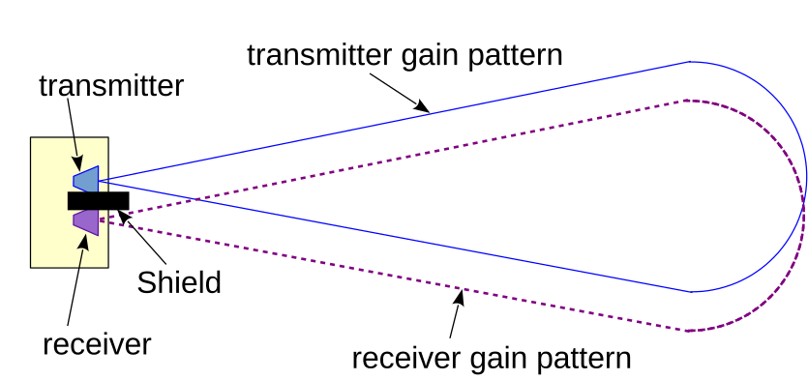
Directional Full Duplex Transceivers
Can transmit and receive simultaneously on same channel
Transmitter and Receiver oriented in same direction
Complex signal processing to cancel transmitter noise in receiver
Data rate increases significantly
Need sophisticated design to discover LOS of a neighbor

Slide 5
Neighbor Discovery in Directional Transceiver
Discovering LOS between two nodes
Without any location measurement
Without any apriori knowledge
Contribution:
discover each other without any knowledge of neighbor’s location
chooses angular speed randomly and reinstates after a threshold time
mechanism works well for both stationary and mobile setting
can be extended to discover multiple neighbors
prototype developed using off the shelf hardware

Slide 6
Outline
Introduction
Motivation
Proposed Model
Algorithms
Prototype
Performance Evaluation
Conclusion and Future Work

Slide 7
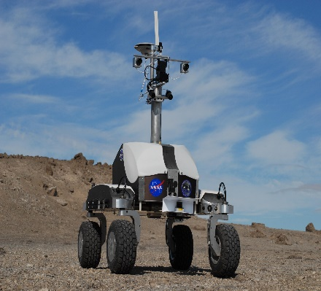
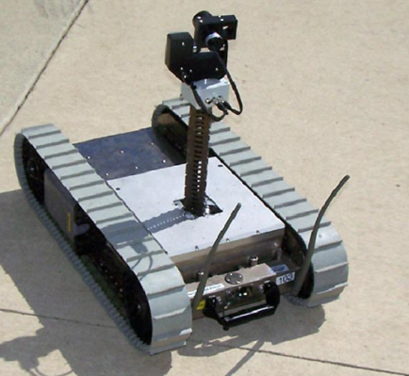
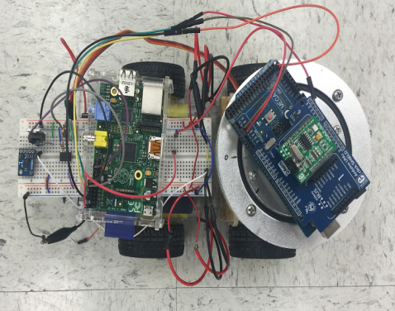
Application
Two PackBots or K-10 Rovers
In-band: No radio or out-of-band channel
GPS-free environment
The PackBot was the first remote controlled robot to enter the Fukushima nuclear facility after the East Japan Earthquake and tsunami in March 2011.

Slide 8
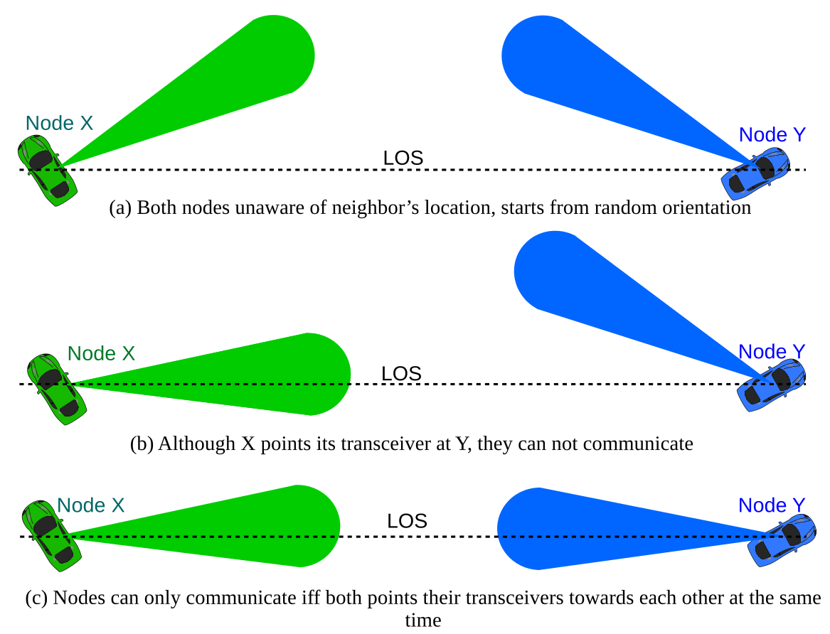
Strict requirement of LOS

Slide 9
Outline
Introduction
Motivation
Proposed Model
Algorithms
Prototype
Performance Evaluation
Conclusion and Future Work

Slide 10
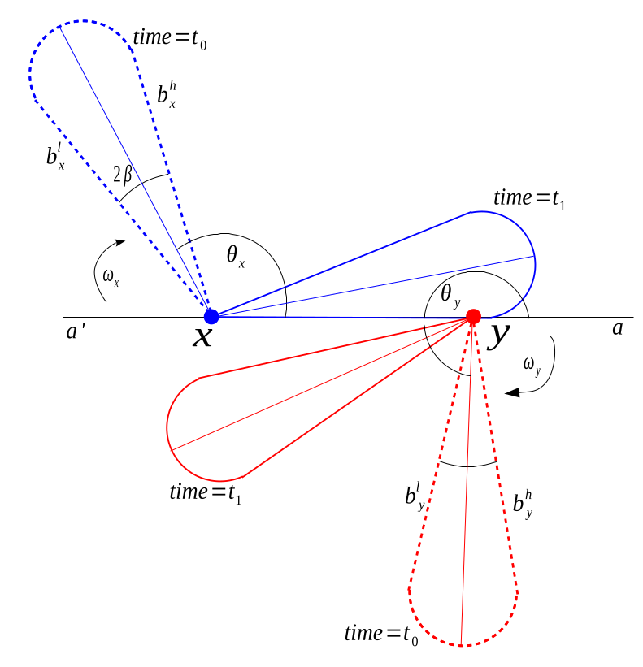
Discovery by continuation rotation
Rotate transceivers
Random angular speed
Both send beacons
Wait for 3-way handshake
Stop rotation upon completion
Restart if not discover for long time
Asynchronous algorithm

Slide 11
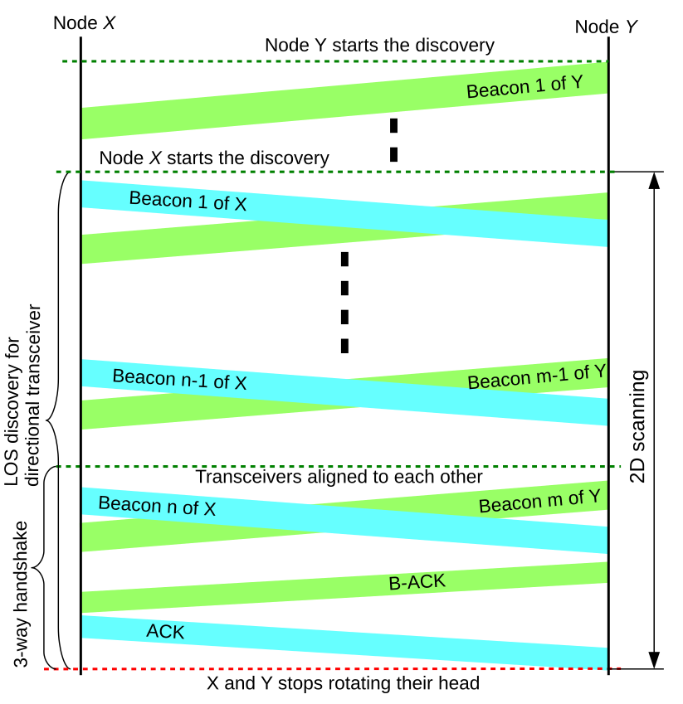
Timing Diagram

Slide 12
Outline
Introduction
Motivation
Proposed Model
Algorithms
Prototype
Performance Evaluation
Conclusion and Future Work

Slide 13
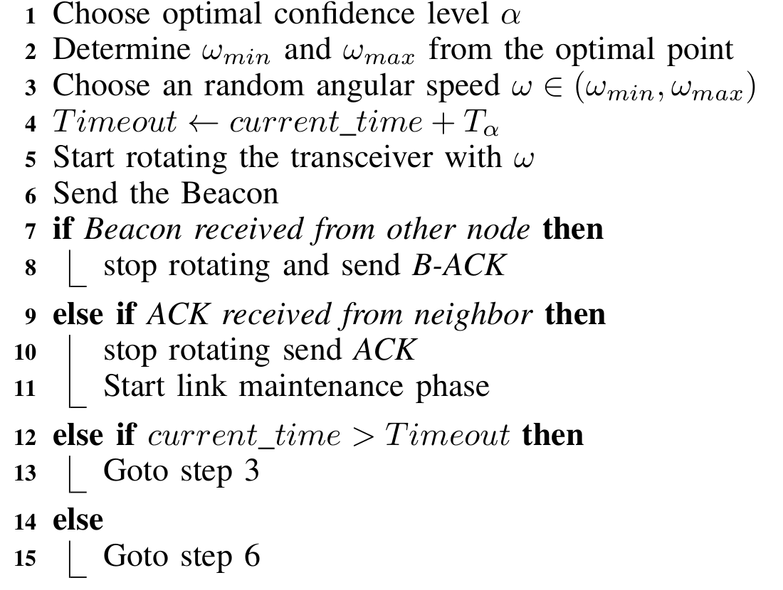
Algorithm for neighbor discovery

Slide 14
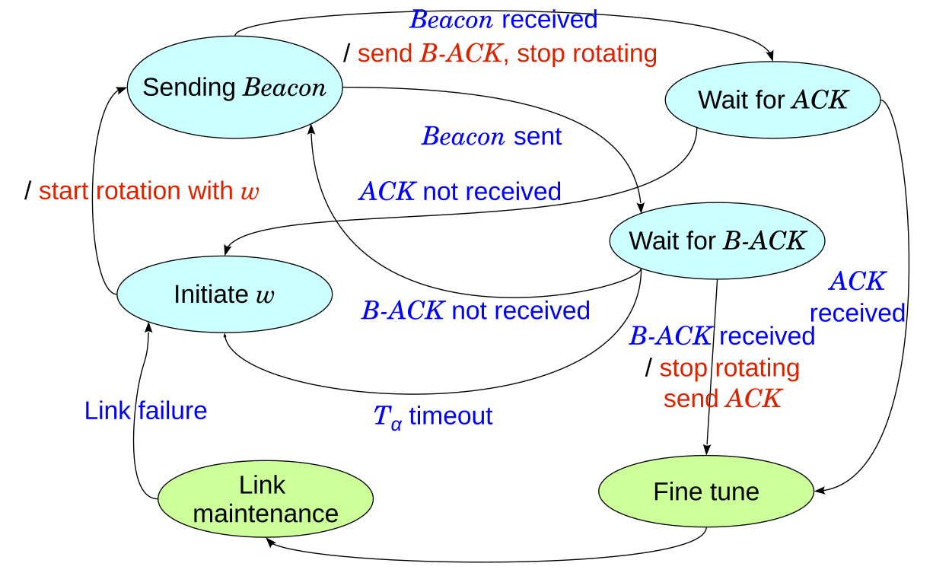
State transition diagram

Slide 15
Outline
Introduction
Motivation
Proposed Model
Algorithms
Prototype
Performance Evaluation
Conclusion and Future Work

Slide 16
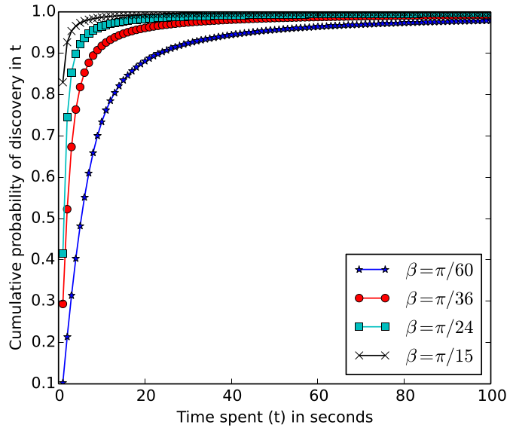
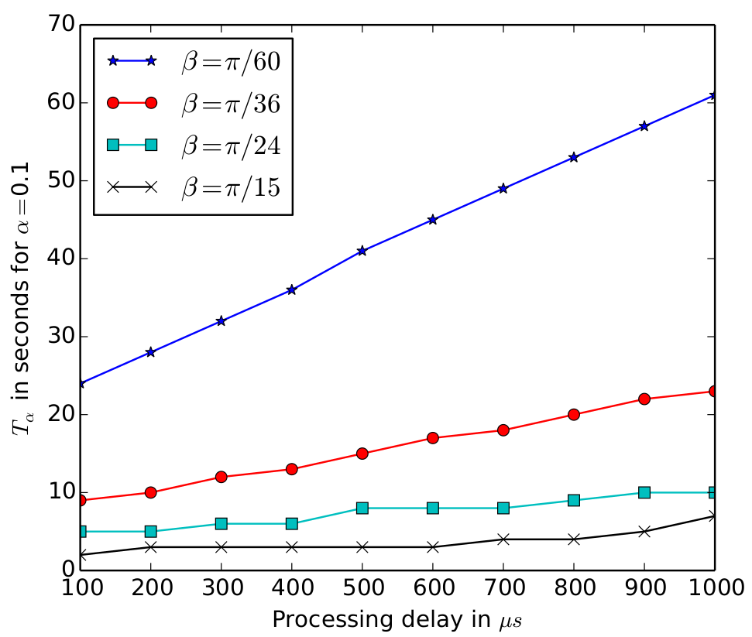
Simulation results
Two static nodes
1112 μs for handshaking
Frame structure similar to WiFi
Data rate of 1Mbps
1,000,000 repetition
Four divergence angles (β)
Determines reset time
Effect of Processing delay

Slide 17
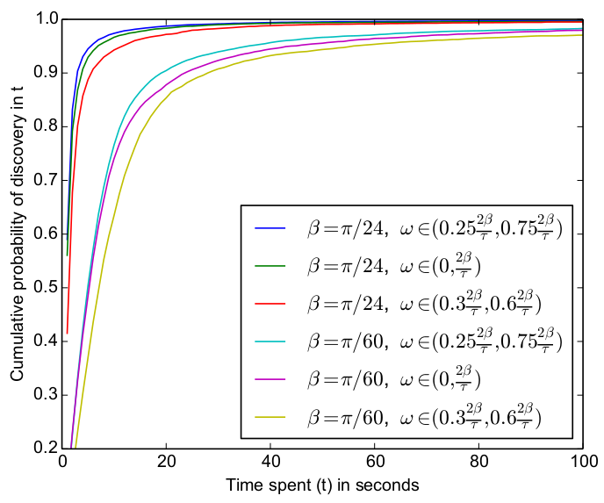
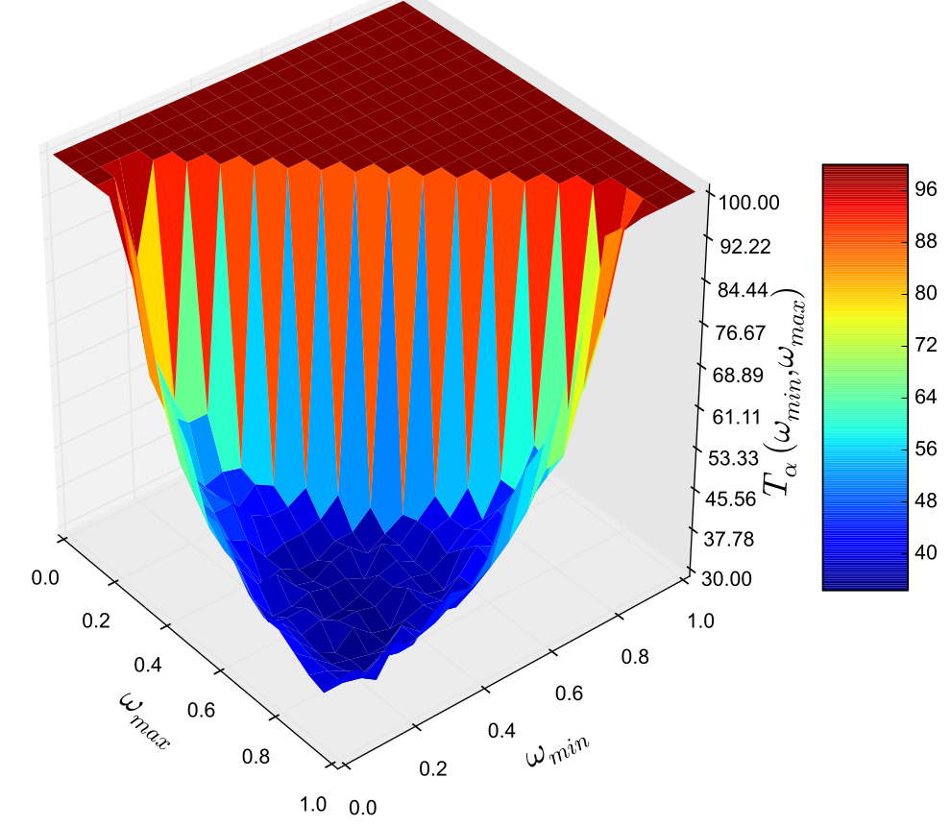
Simulation results …
Hard boundary of angular speed is not optimal
Boundaries are chosen from simulation
Divergence angle of 3^{O}
The optimal point lie in the blue region

Slide 18
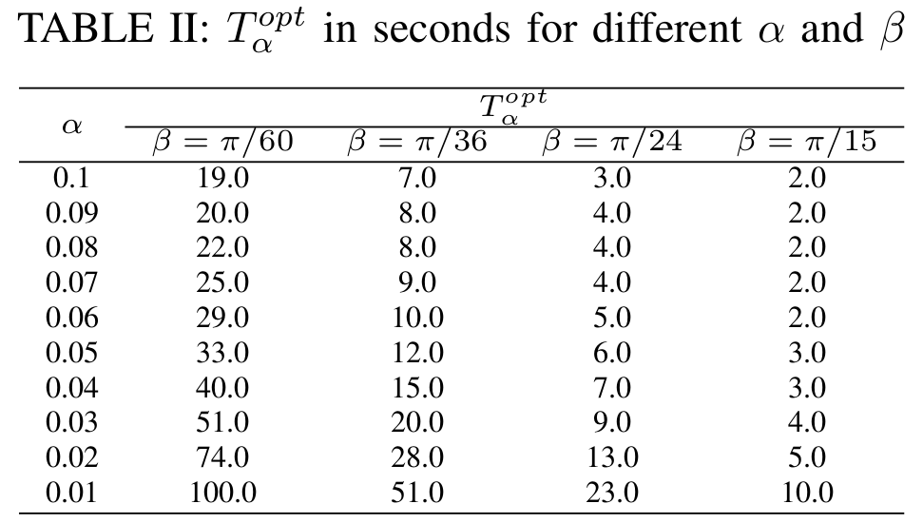

Slide 19
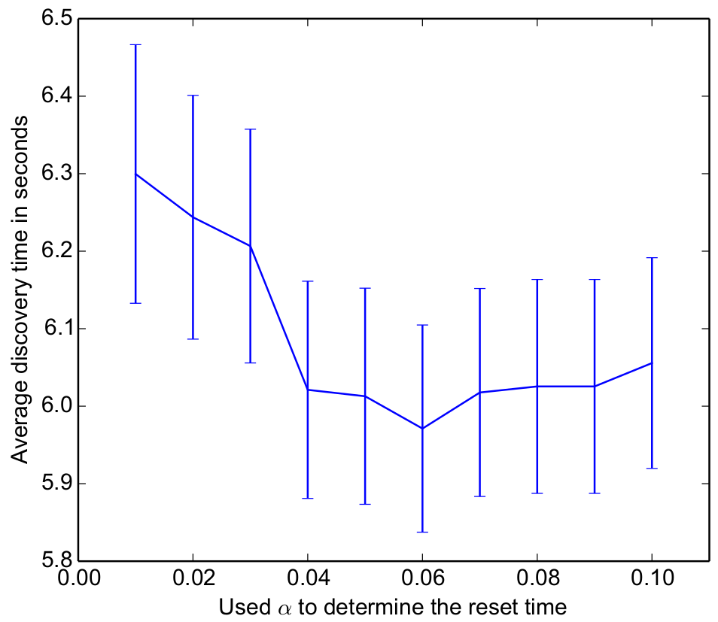
Choosing optimal α
Simulation for mobile node
Divergence angle of 5º
Varying α
Here optimal α is 0.06

Slide 20
Outline
Introduction
Motivation
Proposed Model
Algorithms
Prototype
Performance Evaluation
Conclusion and Future Work

Slide 21
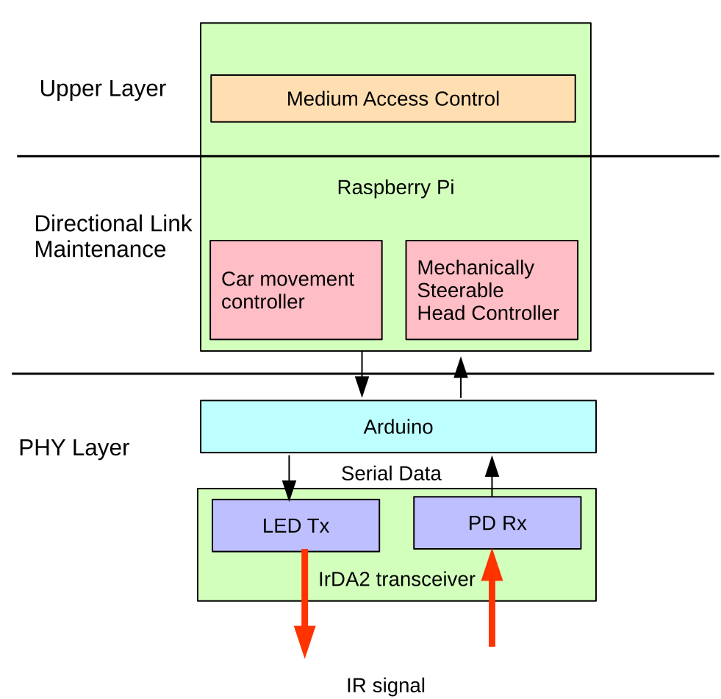
Prototype architecture

Slide 22
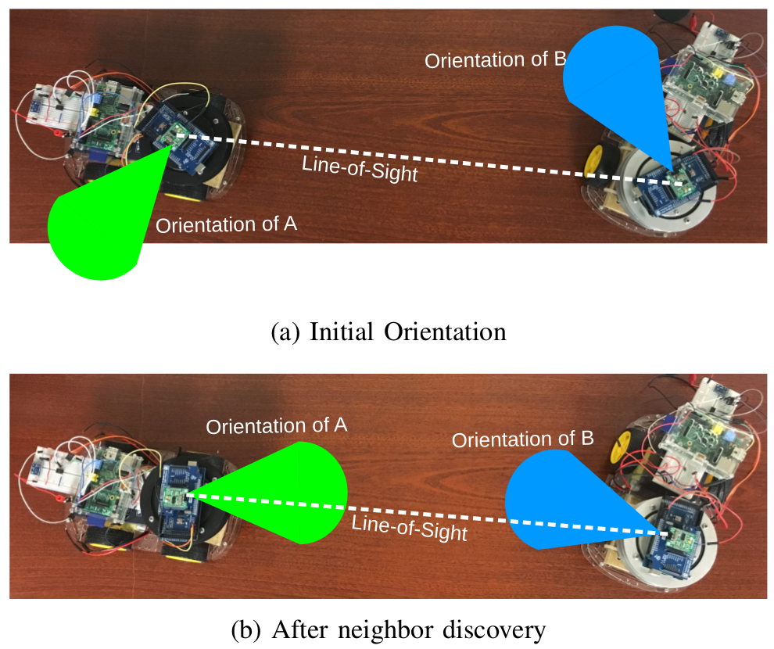
A snapshot of the experiment

Slide 23
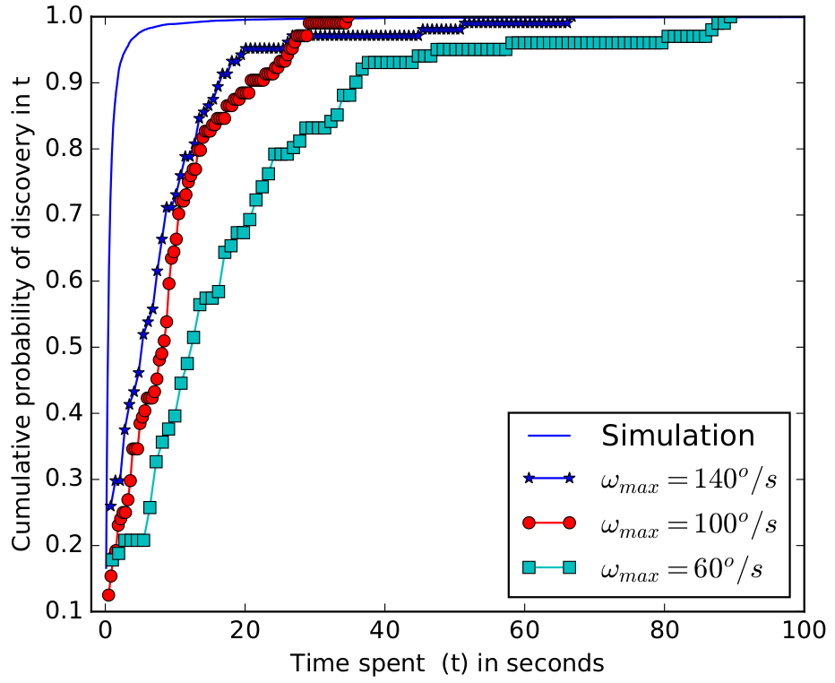
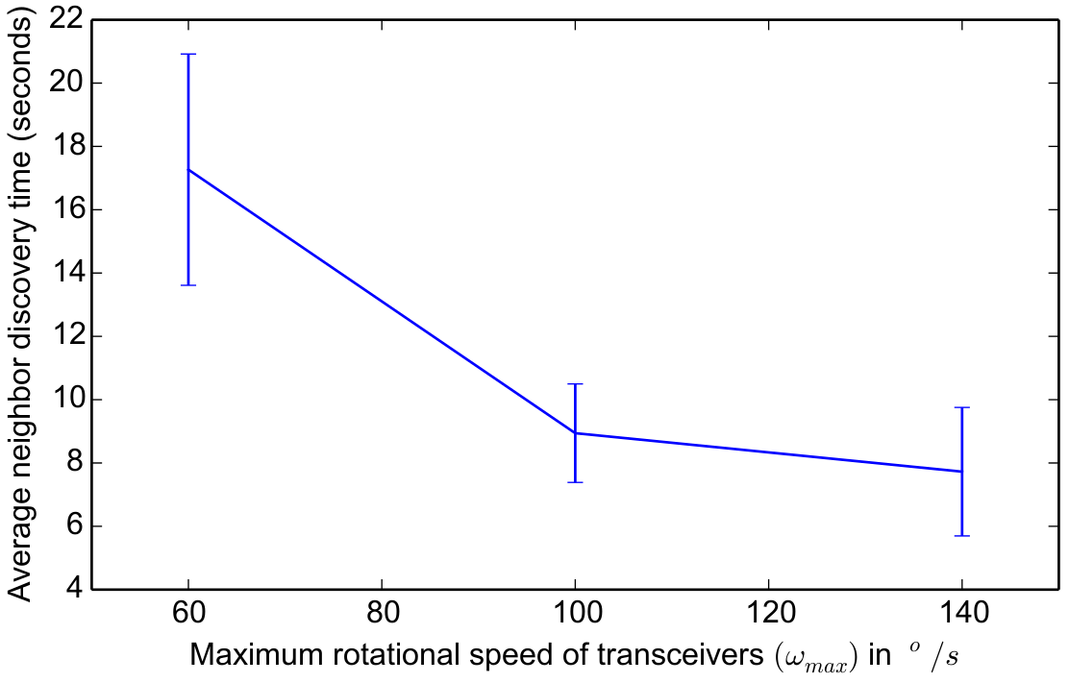
Experiment Results
IR transmitter
divergence angle of 24º
Transmission time 48.44 μs
Processing time 1078.73 μs
Limited angular speed
Speed chosen from (0, ω_{max})
Average discovery time 8.53s

Slide 24
Outline
Introduction
Motivation
Proposed Model
Algorithms
Prototype
Performance Evaluation
Conclusion and Future Work

Slide 25
Conclusion
Proposed a novel approach for discovering a neighbor
line-of-sight (LOS) directional links
in band communication
rotate the transceivers and send search signals
method for finding optimal rotational speeds
reset rotational speed after optimal time
Reasonable discovery period
Works both in stationary and mobile scenarios
Future directions:
in band discovery for 3D
refinement of LOS

Slide 26
Thank You!

Slide 27
Appendix

Slide 28
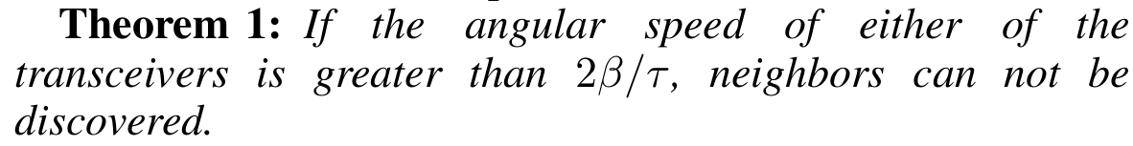
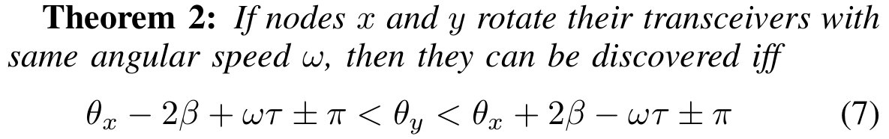
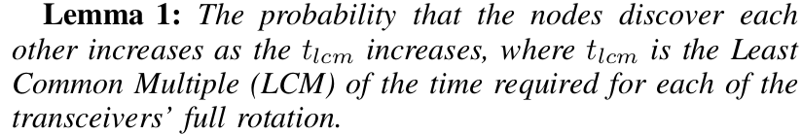
Theorems

Slide 29
Reset angular speed
If neighbors not discovered for long time reset angular speed (ω)
Calculate reset time as:
Optimal reset time
Optimal boundary of angular speed

